Slide 1
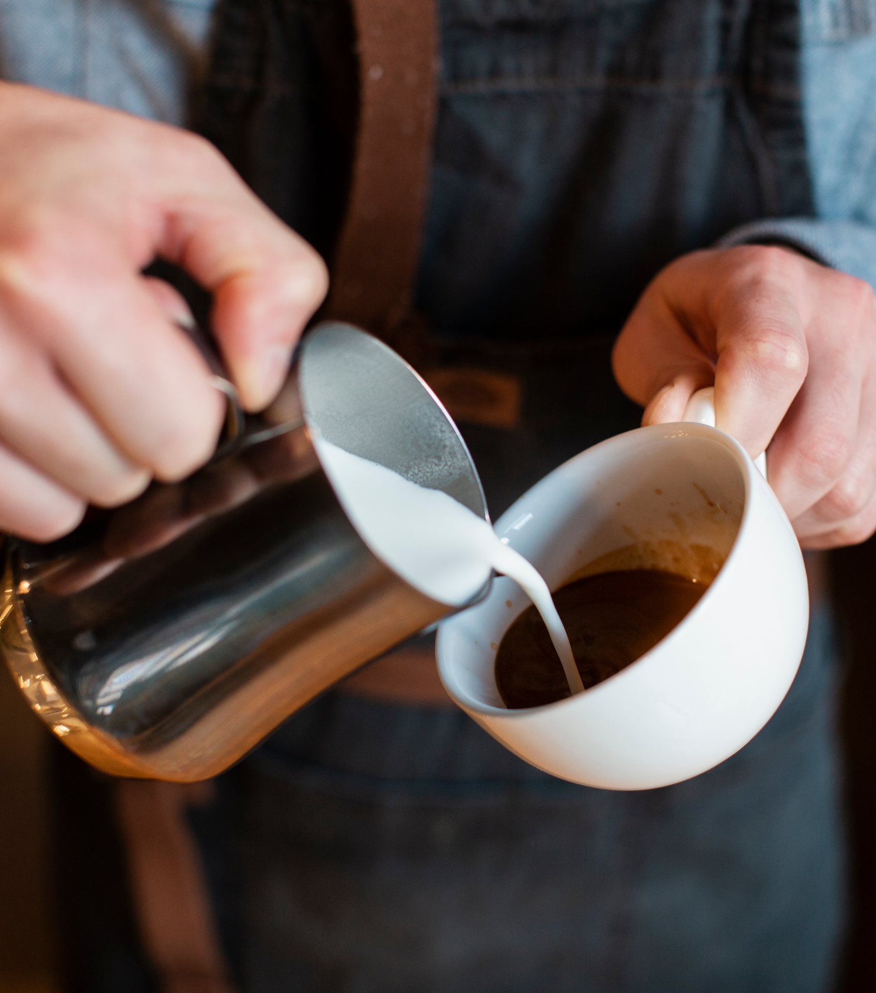
BREW HOUSE
Everything I brew, I brew for you…..☕

Slide 2
TABLE OF CONTENTS
01
02
03
04
05
06
Introduction
Problem statement
Objective
Vision & Mission
07
08
Context diagram & BPMN Model
Technology
& Design
User
Interface
Feature

Slide 3

ABOUT US
COFFEE
"Welcome to the Brew House Coffee Shop, where passion for exceptional coffee meets innovation in every cup, creating a vibrant and immersive experience for coffee enthusiasts."

Slide 4
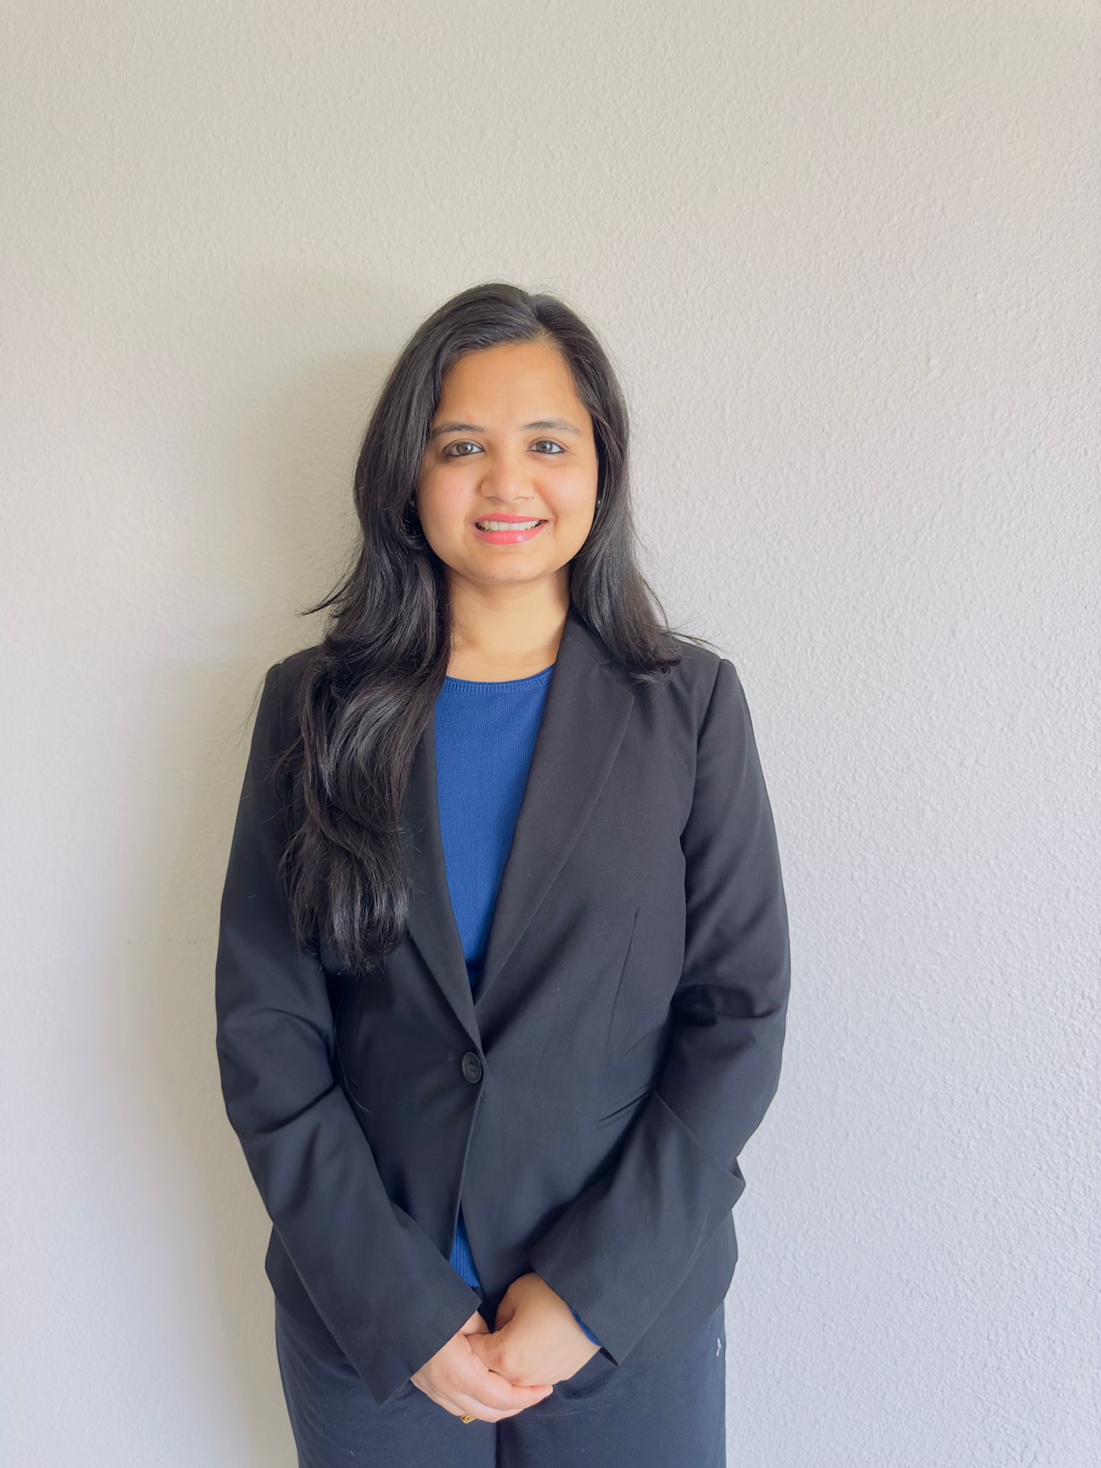
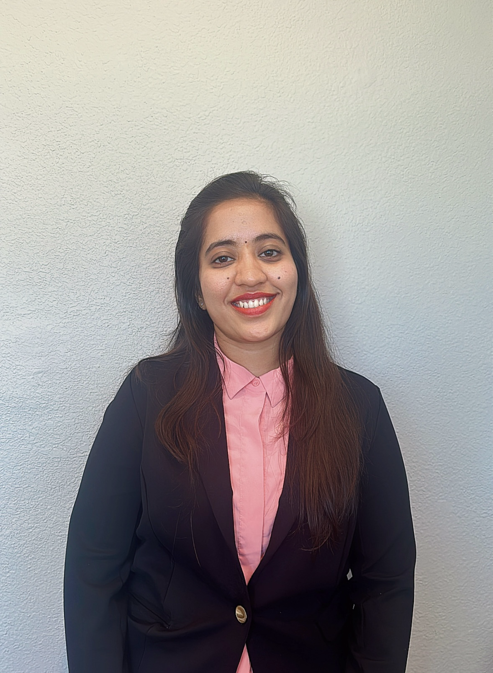

OUR TEAM
Gargi Jain
Vaishnavi Paluru
Dharshini Bala Soundararaj

Slide 5
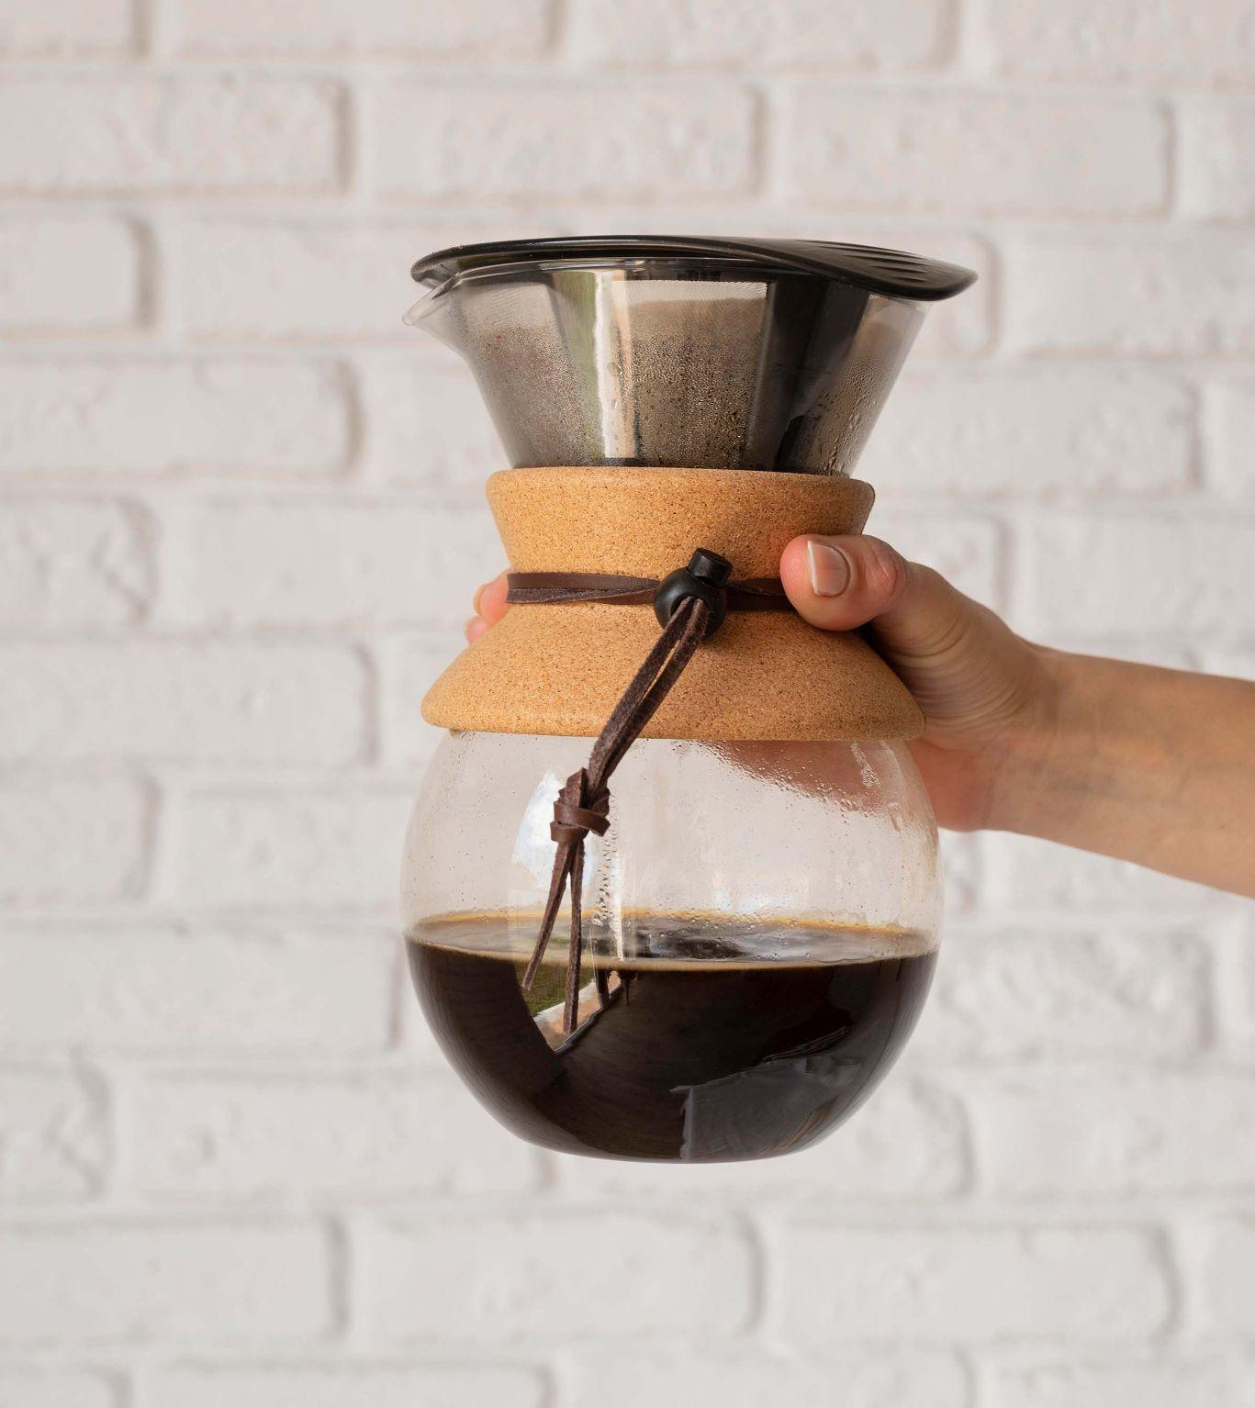
PROBLEM STATEMENT
Limited Repeat Customers
Reliance on Customer Advocacy
The coffee business has very few repeat customers. As a result, we can only generate income from the coffee shop's walk-in customers.
Limited Marketing Channels Relying Solely on Word-of-Mouth Recommendations from Existing Customers
Strategic Marketing Outreach:
Continuous Improvement
Distributed the catchy pamphlets in strategic locations where potential customers are likely to see them.
Utilizing customer Feedback to Enhance Products, Services, and Marketing Approaches
Identified Challenge: Constraints in Reach and Pace of Traditional Marketing Strategies, Compounded by Difficulty in Effectiveness Tracking; Urgent Requirement for an Effective Digital Marketing Strategy to Accelerate Consumer Acquisition and Deliver Prompt Results.

Slide 6

Vision: To transform Current Brew House’s Coffee shop into a thriving hub by pioneering digital marketing solutions that seamlessly connect with our community, elevate customer experiences, and redefine the coffee shop landscape. Mission: Our mission is to revolutionize revenue generation by implementing innovative digital marketing strategies. We aim to enhance customer engagement, attract a broader audience, and foster brand loyalty. Through leveraging real-time data and personalized approaches, we strive to create a dynamic and tech-savvy coffee shop experience, delivering value to both our customers and the business.

Slide 7
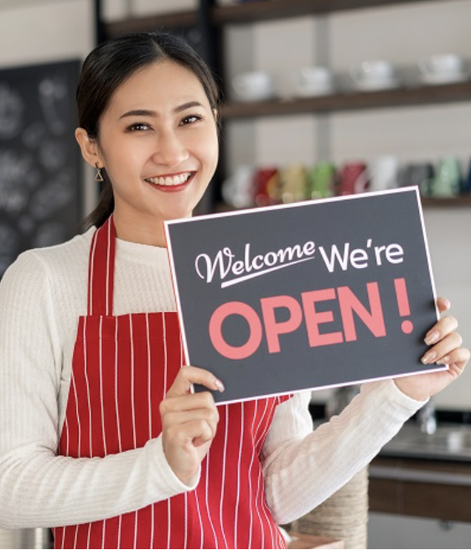
OUR PROPOSED SOLUTION
Develop a robust system capable of precisely identifying and targeting consumers in real time based on their location.
Employ a geofencing strategy to deliver personalized coupons to consumers near the coffee shop.
Utilize a geo-conquesting strategy to engage consumers near competing establishments and entice them to the coffee shop.
Create a mechanism for tailoring coupons and promotions according to individual consumer profiles, preferences, behavior, and location.
Ensure seamless access and processing of real-time location data from consumers' mobile devices within the system.
Integrate tracking and analytics features to assess the effectiveness of marketing campaigns and make informed adjustments.
Establish a reliable notification delivery mechanism to guarantee timely receipt of coupons and promotions on consumers' mobile devices.
Optimize the system for cost-effectiveness, considering factors such as data usage and cloud infrastructure costs.
Develop an intuitive and user-friendly interface for coffee shop staff to efficiently manage, monitor, and derive insights from marketing campaigns.

Slide 8
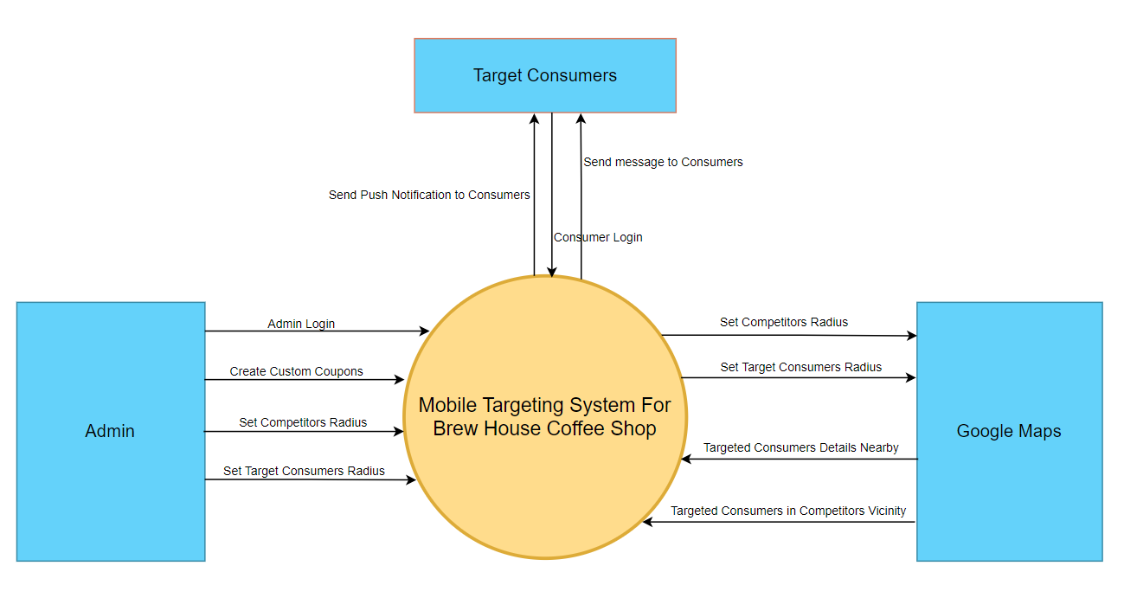
CONTEXT DIAGRAM

Slide 9
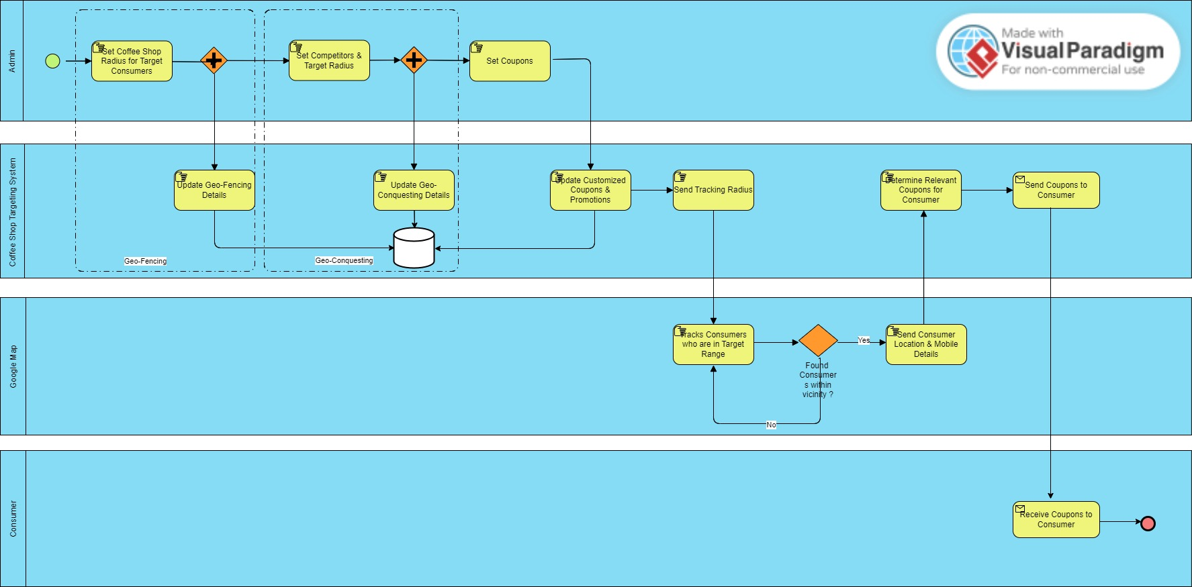
BPMN MODEL

Slide 10
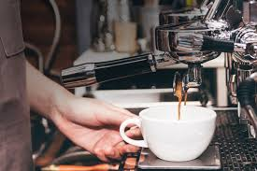
Technology and Design
Mobile App Development:
Objective: Develop a user-friendly and feature-rich mobile application for Current Brew House's Coffee Shop to facilitate seamless interaction with the Mobile Targeting System.
Technologies:
Frontend: React Native
Platform: iOS, Android
Backend Development:
Objective: Establish a robust backend infrastructure to support the functionalities of the Mobile Targeting System and ensure efficient data processing.
Technologies:
Backend Framework: Node.js
Database: MongoDB
Server Hosting: Amazon Web Services (AWS)
APIs and Web Services:
Objective: Create secure and scalable APIs and web services to enable communication between the mobile application and backend systems.
Technologies:
RESTful APIs
Express.js

Slide 11

Technology and Design
4.Geo-Conquesting and Geo-Fencing:
Objective: Implement geolocation-based strategies to target and engage consumers with precision, leveraging geo-conquesting for competitor targeting and geo-fencing for proximity-based outreach.
Technologies:
Geo-Fencing: Google Geofencing API
Geo-Conquesting: Location-based Services (LBS)
5.Data Storage and Database:
Objective: Establish a reliable and scalable data storage solution and database architecture to store and retrieve consumer information, preferences, and behavior data.
Technologies:
Database: MongoDB
Cloud Storage: Amazon S3

Slide 12
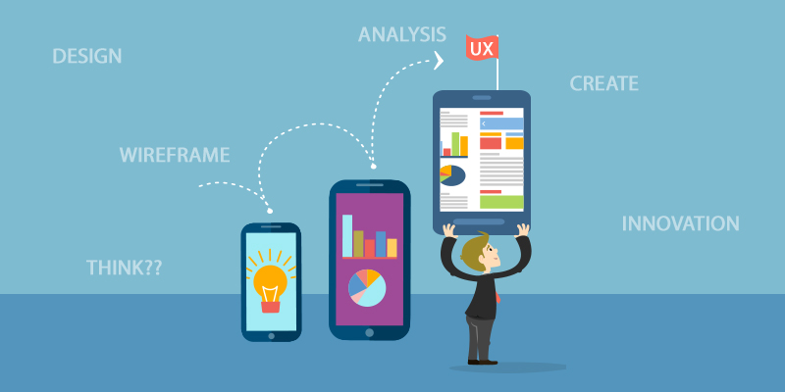
APPLICATION FEATURES
User Authentication
Personalized Profiles
Real-Time Location Tracking
Customized Coupons and Promotions
Push Notifications
Feedback and Surveys
Social Media Integration
In-App Messaging
Order and Payment Integration
Analytics Dashboard

Slide 13
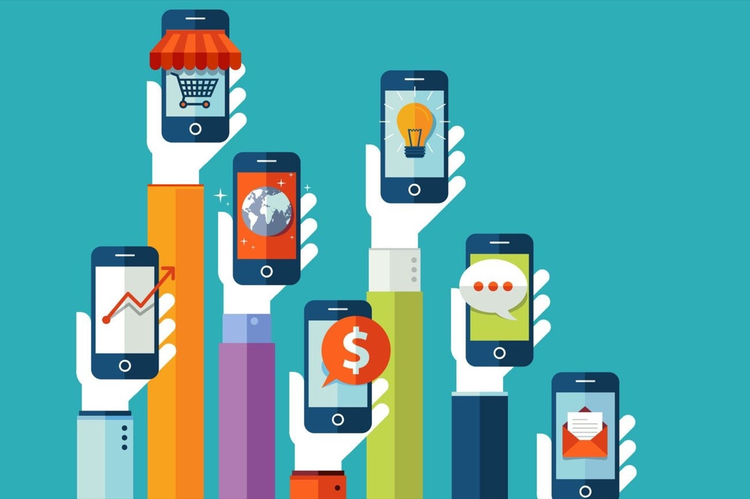
DEVICE FEATURES
Location Services:
Push Notification Capability:
Internet Connectivity:
Camera Access:
Touchscreen Interface:
Operating System Compatibility:
Biometric Authentication:
Storage Capacity:
Responsive Design:

Slide 14
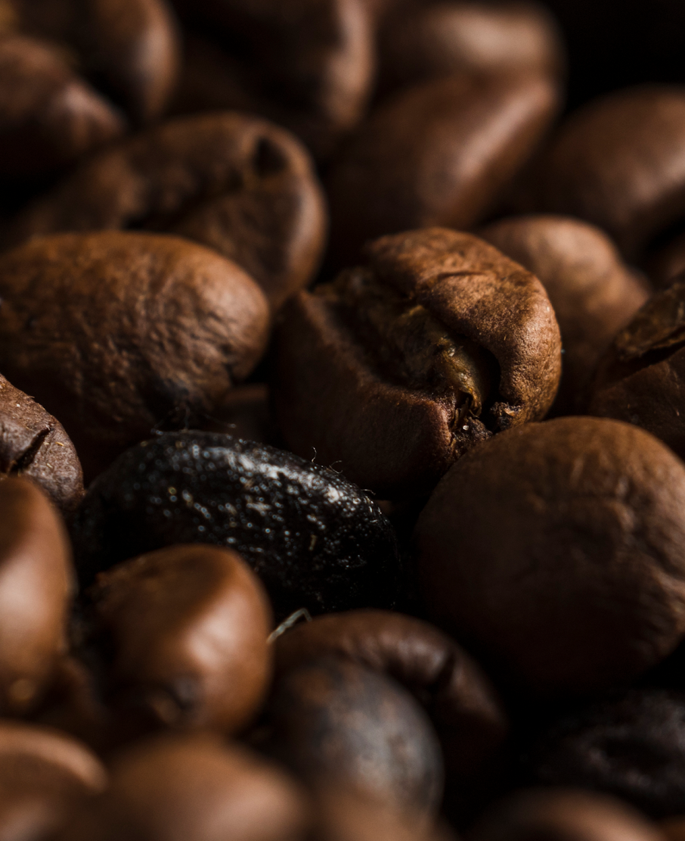
UNIQUE FEATURES
Dynamic Geo-Conquesting Intelligence:
Utilize advanced algorithms to dynamically adjust geo-conquesting strategies based on real-time competitor locations and consumer behavior patterns.
Augmented Reality Coffee Experience:
Integrate augmented reality features allowing users to virtually explore new coffee blends and promotions.
CO
FF
EE

Slide 15
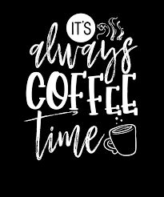
All you need is love and a cup of coffee☕
—SOMEONE FAMOUS

Slide 16
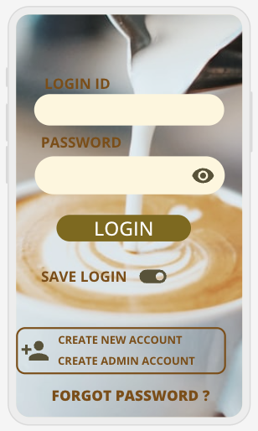
USER INTERFACE
LOGIN PAGE:

Slide 17
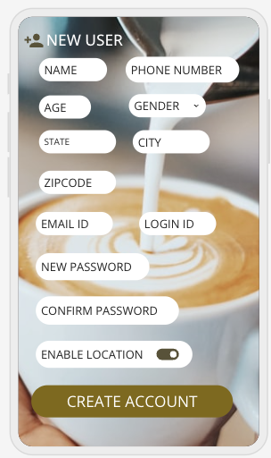
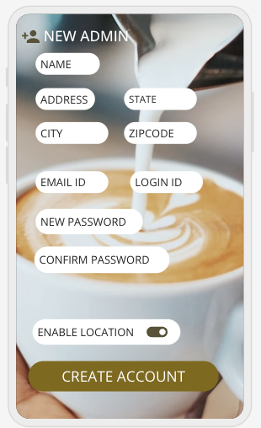
NEW USER CREATION PAGE

Slide 18
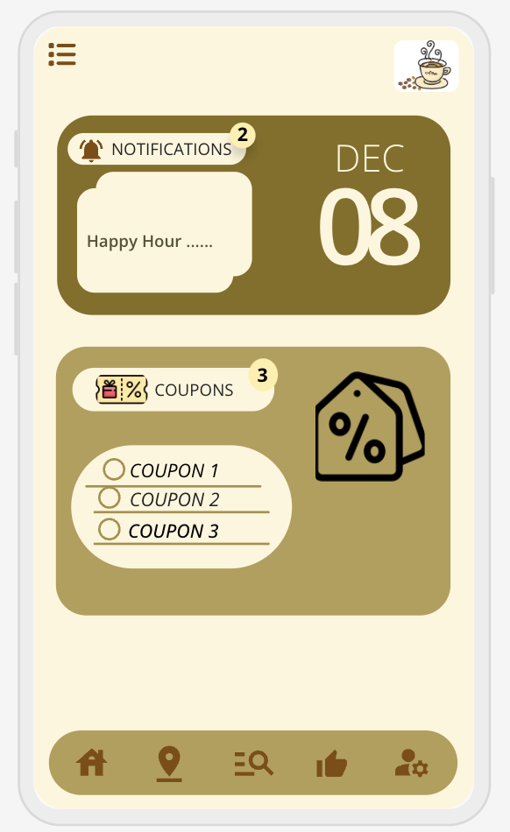
USER HOME PAGE

Slide 19
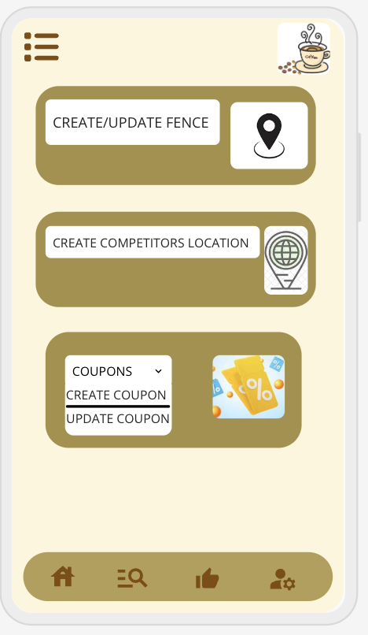
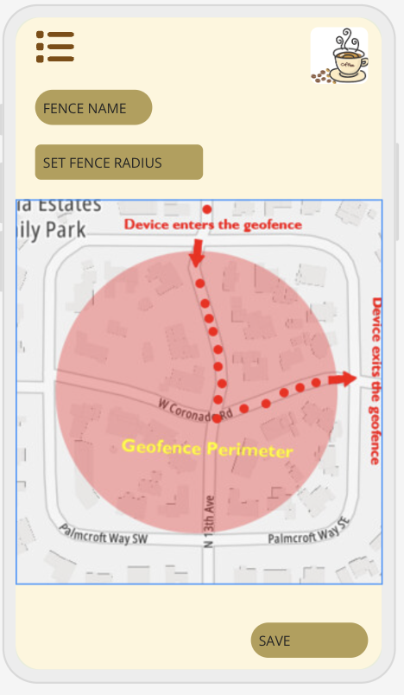
ADMIN INTERFACE

Slide 20
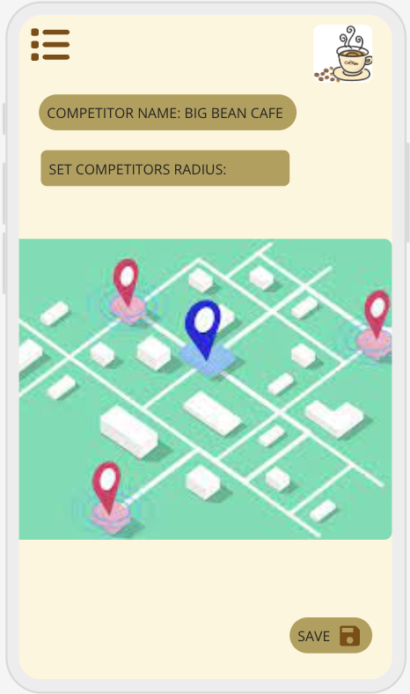
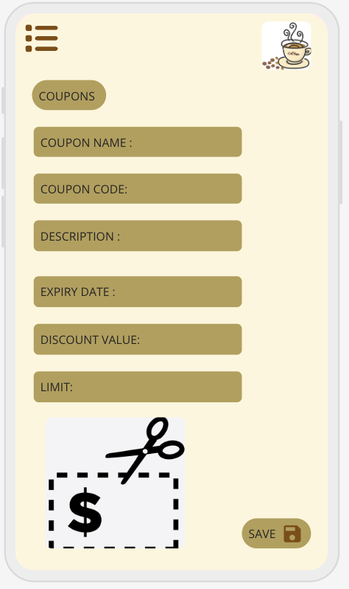
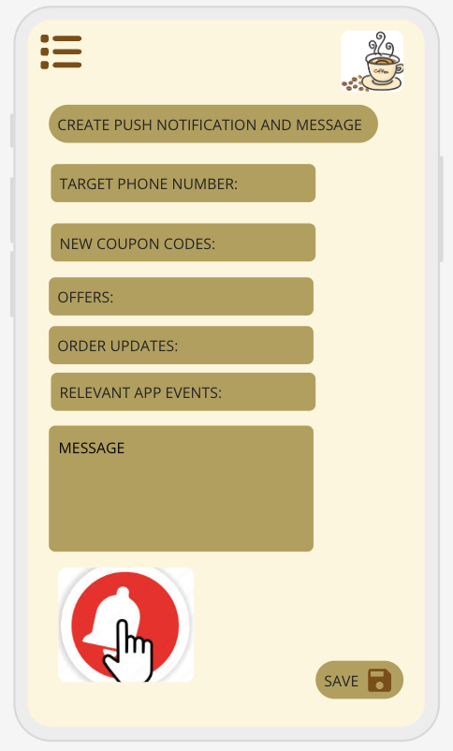

Slide 21
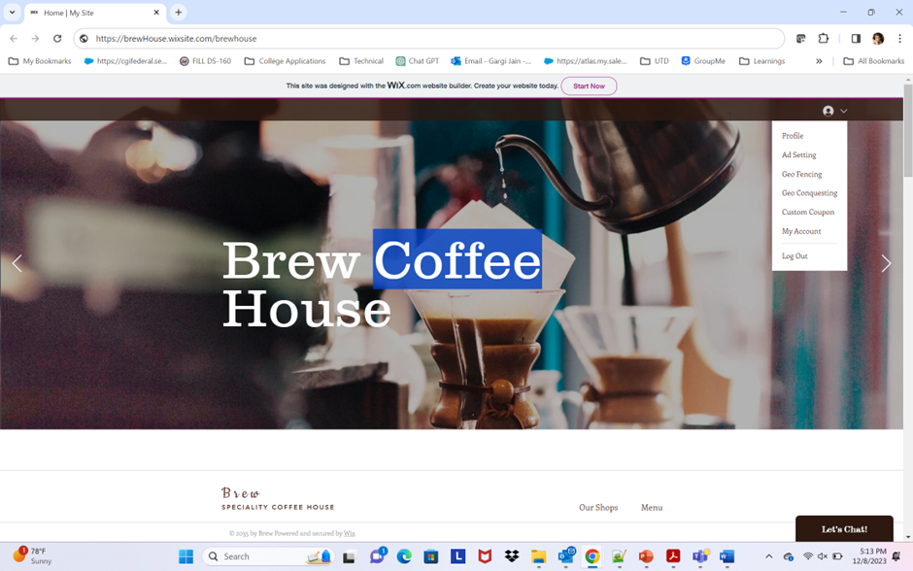
PROTOTYPE

Slide 22
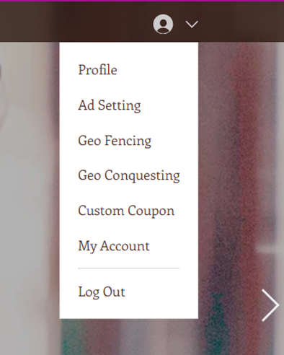
Services Section – Add Coupons, Set GeoFence, Set Geo Conquest Radius

Slide 23
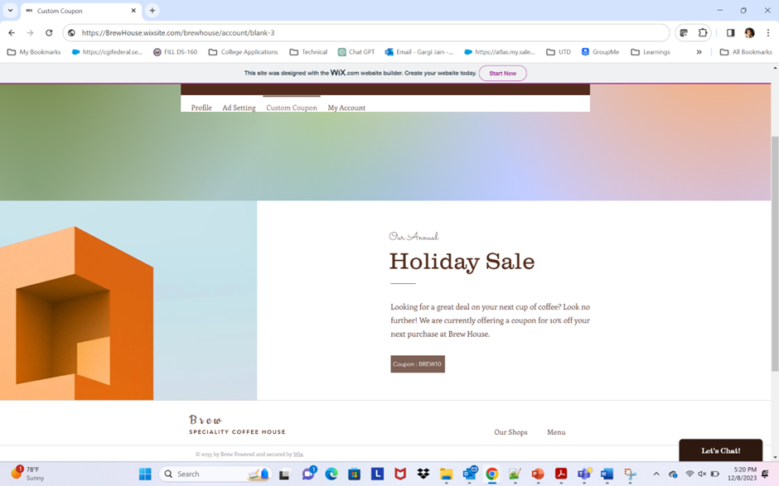
Coupons Sections – Admin can add all valid coupons

Slide 24
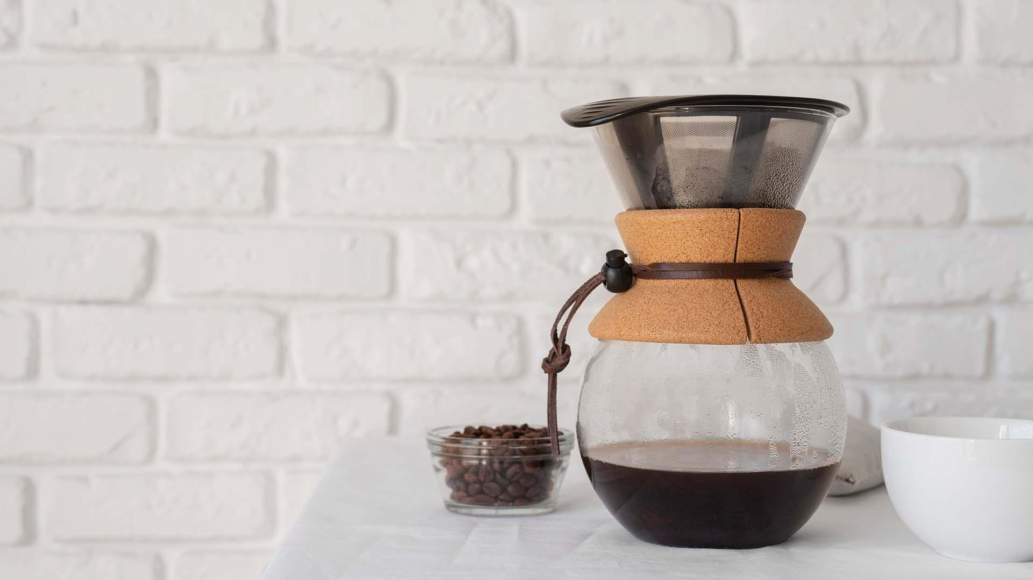
A PICTURE IS WORTH A THOUSAND WORDS

Slide 25


